Slide 1
Clinical Neuroscience: NeuroRehabiliation
14.5.2018
Part 1: Neurobiological basis of repair and neurorehabilitation after traumatic CNS injuries
Martin E. Schwab
Part 2: Mechanisms of stroke recovery and novel therapeutic approaches
Roger Gassert

Slide 2
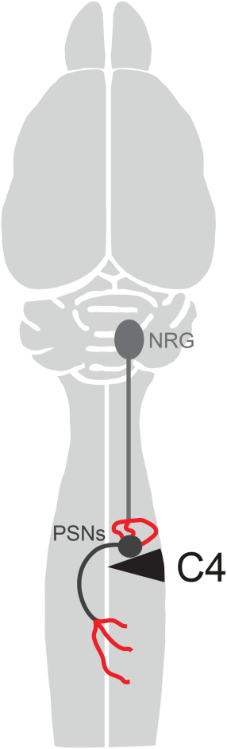
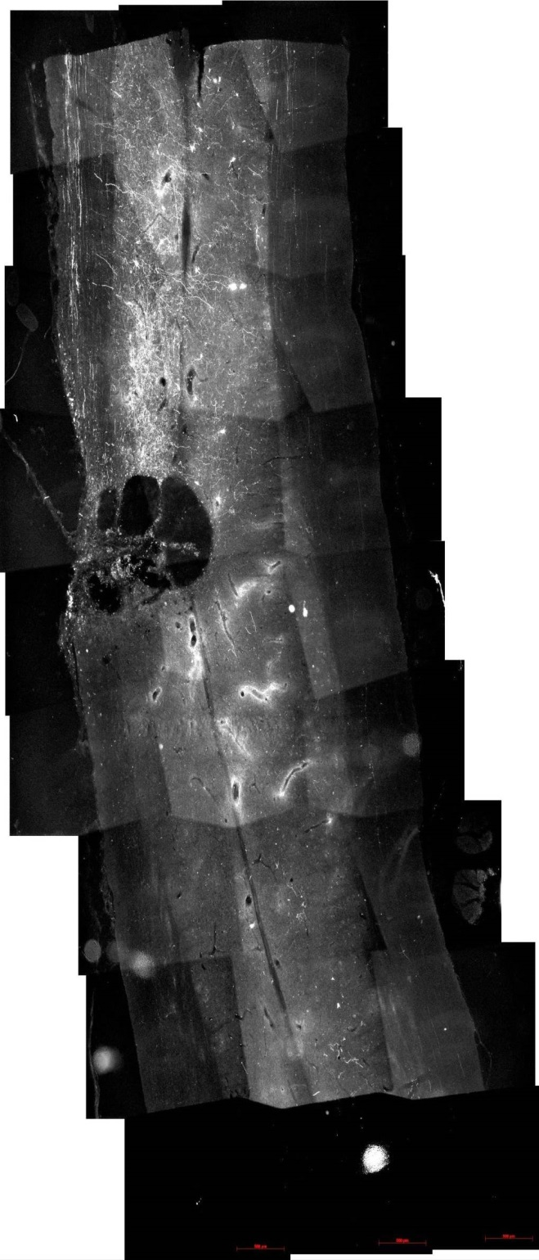
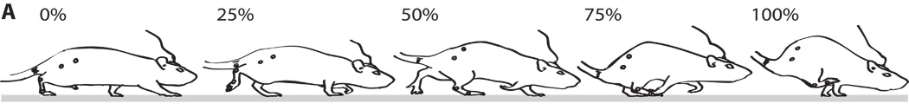
Neurobiological basis of repair and neurorehabilitation after traumatic CNS injuries 14.5.2018
Martin E. Schwab, Brain Research Institute, University of Zurich
and D-HEST, ETH Zurich

Slide 3
Physical trauma to brain or spinal cord: 3 phases
Immediate destruction of tissue (necrotic death; 1-60 min.)
Followed by secondary degenerative events due to different mechanisms (30 min. – days):
ischemia in surrounding tissue due to microthrombosis of blood
vessels: Slow ischemic death of neurons, often by apoptosis
release of neurotransmitters from ischemic terminals. High levels of
glutamate lead to over-excitation of neurons and toxic intracellular Ca-concentrations (‘excitotoxicity’)
free radical formation (catalyzed by iron from bleedings): lipid peroxidation and membrane damage
inflammation
myelin damage, demyelination of intact fibers
pressure damage by edema
Late phase: Scar formation (by astrocytes, microglia/macrophages and menigeal fibroblasts) and cyst formation (filled with cerebrospinal fluid)

Slide 4
Stroke: Ischemic (blocked blood vessels; ischemic stroke) or by bleeding (hemorrhagic stroke); 3 phases:
Fast necrotic tissue death in the center of the lesion
Followed by slower degenerative processes in surrounding (‘penumbra’), very similar to mechanical trauma
Late phase: Fluid-filled ‘holes’ surrounded by scar

Slide 5
Functional consequences of the lesion:
Immediate loss of the functionality of fiber tracts and circuits:
Paraplegia: thoracic or lumbar spinal cord injury, legs and lower body
Tetraplegia: cervical spinal cord injury, upper and lower extremities
Loss of sensation, loss of movement control, loss of bladder and bowel control
Hemiplegia, hemiparesis: Impairment of one side of the body after stroke (normally unilateral) or unilateral spinal cord injury
1-6 mts. after incomplete spinal cord injuries or smaller strokes: Gradual, often partial recovery of certain functions
- Neurobiological mechanisms of this recovery: under investigation
- clinical, therapeutic approach: Rehabilitative training

Slide 6
Mechanisms of structural and functional repair after CNS trauma
Regenerative sprouting and elongation of injured axons, formation of relay circuits
Many CNS axons react to injuries by a transitory regeneration attempt. These sprouts can connect to targets proximal to the lesion (ex.: Hind limb motor cortex axon collaterals connect to cervical spinal cord and assume forelimb functions). They can also contact spared propriospinal neurons that ‘bridge’ the lesion and form a ‘relay pathway’. Regeneration can be stimulated (antibodies against growth inhibitors, e.g. Nogo-A; growth factors)
Compensatory sprouting of intact, spared fibers, functional map shifts
  Intact fibers sprout and take over targets that have lost their input. The neurons of origin have to change and adapt their input connection to form a new functional circuit. (Ex.: After smaller stroke lesions, neighboring parts of the motor cortex assume control over body parts that have lost their input: ‘remapping’ of motor cortex)
new neurons or new oligodendrocytes (myelin repair)
  Proliferation of stem cells is frequently observed in regions surrounding the trauma site, but new neurons are absent, new astrocytes contribute to the scar, and some cells (10%) differentiate into oligodendrocytes which can form new myelin (only animal data so far).

Slide 7
Rehabiliative, intense, repetitive training in rats induces:
strengthening of preexisting connections spared by the lesion, e.g. by potentiation of synapses (LTP)
stabilization of newly formed connections; selection of functionally meaningful connections out of ‘randomly’ formed circuits, pruning and elimination of malfunctional connections
induction of growth (via up-regulation of growth factors ?)
Important questions for clinical rehabilitation:
Optimal type of training?
- Optimal time window after the lesion?
- Optimal intensity and duration?
- Combination of growth enhancing therapies and training

